Slide 1
Create OpenAPI Documents with Swagger Editor

Slide 2

Access and navigate Swagger Editor and create a new OpenAPI 2.0 document
Version and document information
GET operation
Paths for routing requests
Producers and Consumers for declaring MIME types of payloads
Parameters for RESTful requests
Responses for RESTful responses
$ref and definitions for type reuse
Security Defintions
POST, PUT, DELETE operations
Host, schema, and basePath for declaring the endpoint
Overview

Slide 3
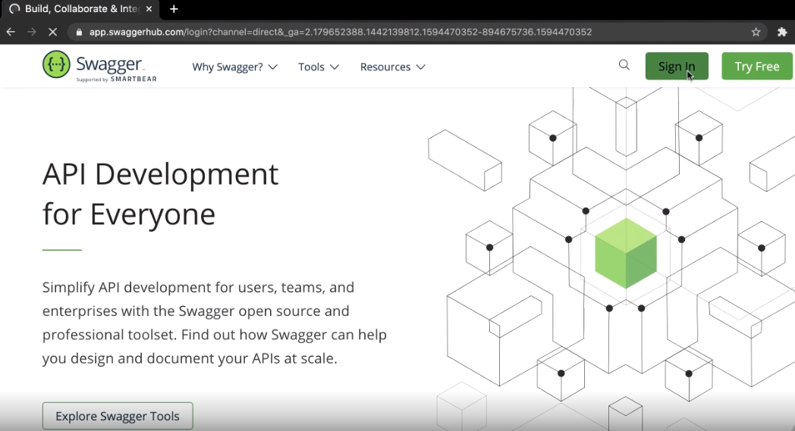

Slide 4
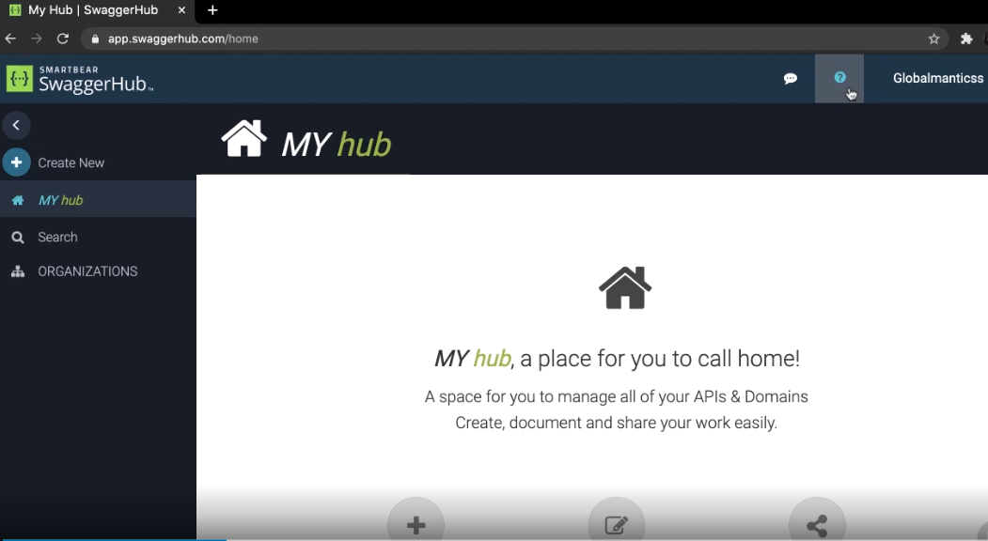

Slide 5
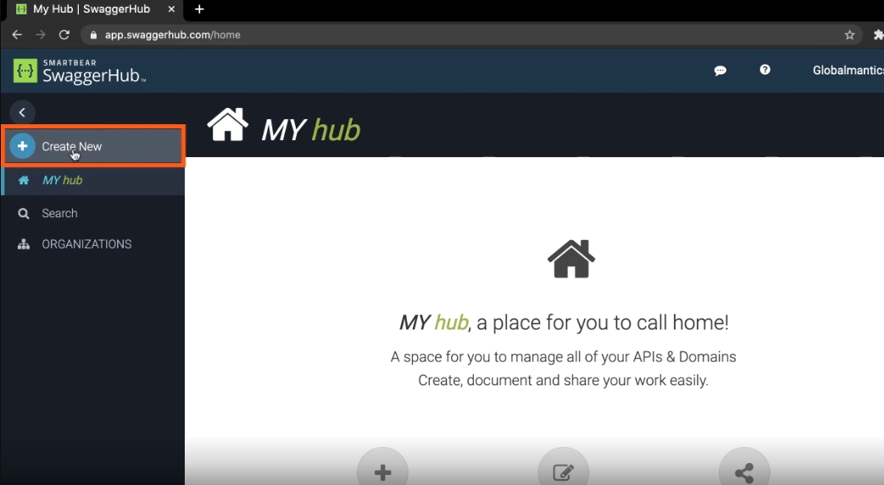

Slide 6
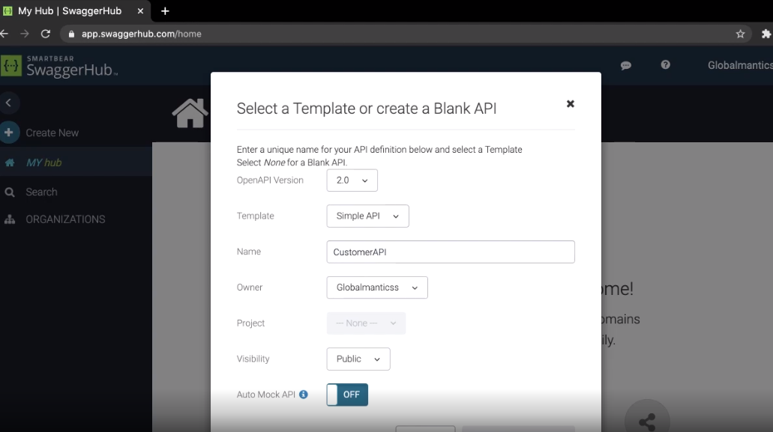

Slide 7
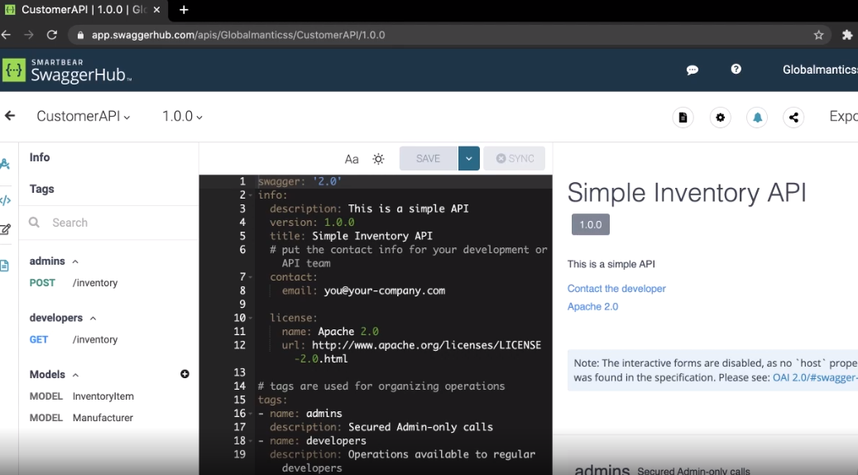

Slide 8
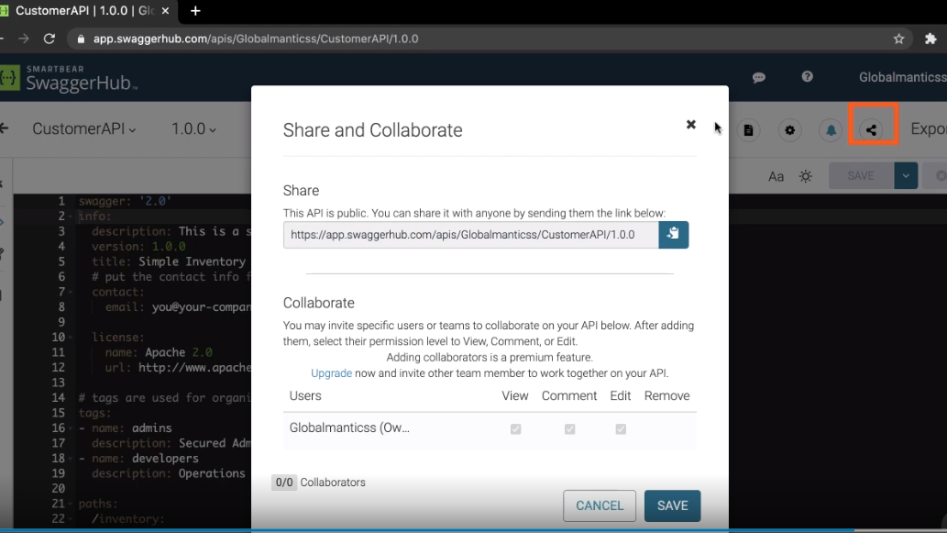

Slide 9
OpenAPI 2.0: Version and Info

Slide 10
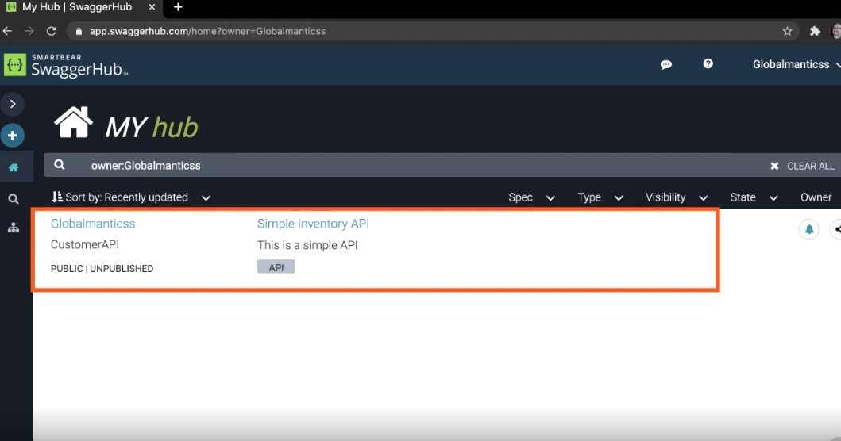

Slide 11
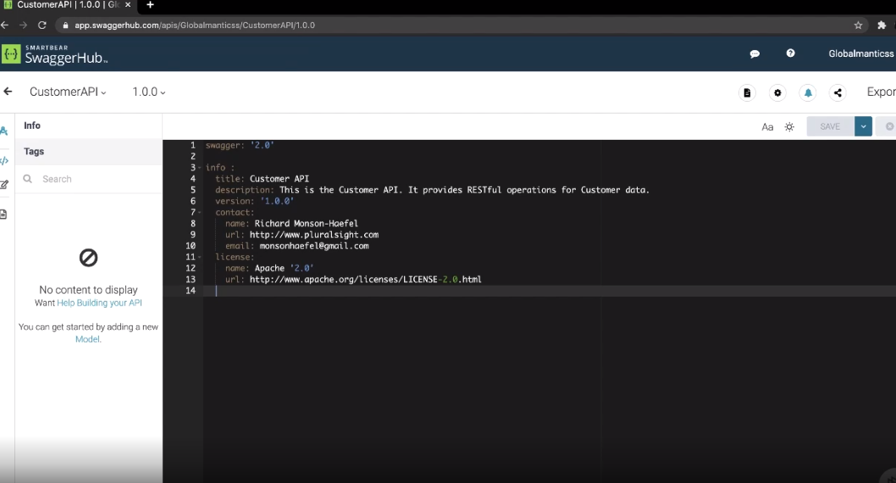

Slide 12
OpenAPI 2.0: Paths and GET Operation

Slide 13
Base URL:
http://globalmantics.com
Path:
/customer
Full URL:
http://globalmantics.com/customer

Slide 14
OpenAPI 2.0: Produces, Consumes and
Parameters

Slide 15
Parameter Name
http://globalmantics.com/customer?customerId=123
Full URL
Query string

Slide 16
Integer Value
http://globalmantics.com/customer?customerId=123
Full URL
Query string

Slide 17
OpenAPI 2.0: Responses

Slide 18


The GET Operation
HTTP GET Request

Slide 19

The GET Operation
HTTP GET Request
HTTP GET Response

Slide 20

customer.json
{
“customerId” : 938320,
“accountValue” : 1240.23, “customerName” : “Better Books, Inc.”, “active” : true,
“address” : {
“name” : “Better Books, Inc.”,
“street” : “121 Maple Street”, “city” : “New York”,
“state” : “NY”,
“zip” : “90015”
},
“contacts” :[{ “name” : “John Doe”, “email : “jdoe@bb.com”, “phone” : “555-555-5555” },
{ “name” : “Jane Syl”, “email : “jsyl@bb.com”, “phone” : “555-555-5555” },
{ “name” : “Bill Row”, “email : “brow@bb.com”, “phone” : “555-555-5555” }]
}

Slide 21
customer.json
{
“customerId” : 938320,
“accountValue” : 1240.23, “customerName” : “Better Books, Inc.”, “active” : true,
“address” : {
“name” : “Better Books, Inc.”,
“street” : “121 Maple Street”, “city” : “New York”,
“state” : “NY”,
“zip” : “90015”
},
“contacts” :[{ “name” : “John Doe”, “email : “jdoe@bb.com”, “phone” : “555-555-5555” },
{ “name” : “Jane Syl”, “email : “jsyl@bb.com”, “phone” : “555-555-5555” },
{ “name” : “Bill Row”, “email : “brow@bb.com”, “phone” : “555-555-5555” }]
}

Slide 22
OpenAPI 2.0: References and Definitions

Slide 23
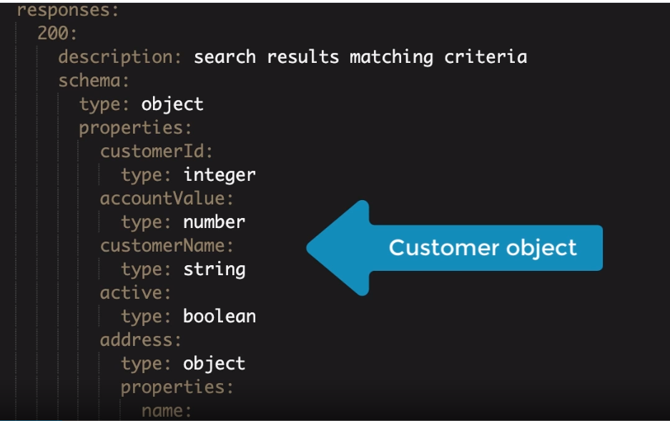

Slide 24
OpenAPI 2.0: Post, Put, Delete

Slide 25
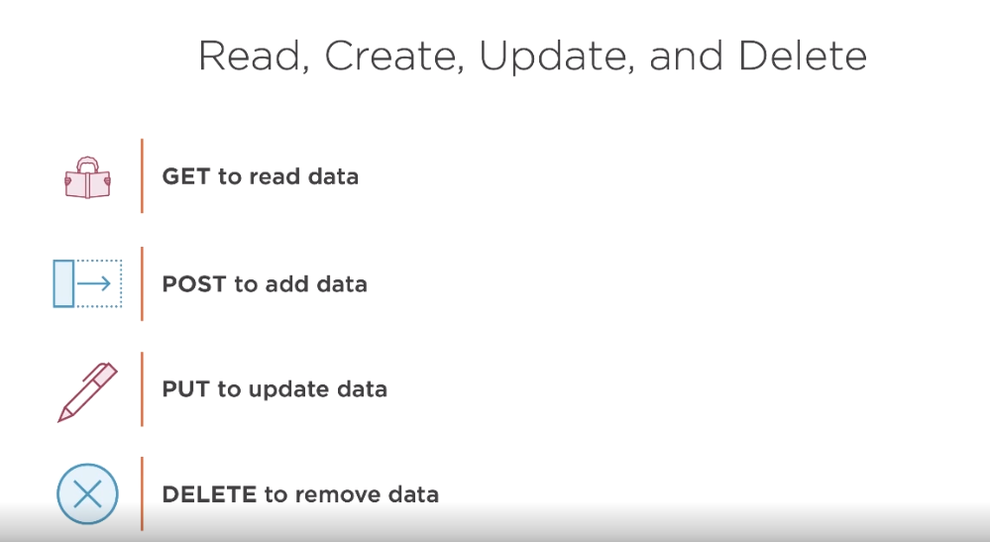

Slide 26
HTTP POST

Slide 27
The POST Operation
HTTP POST Request

Slide 28

The POST Operation
HTTP POST Request
HTTP POST Response
ID
ID

Slide 29
HTTP PUT

Slide 30

The PUT Operation
HTTP PUT Request
+ ID

Slide 31
The PUT Operation
http://goblamantics.com/customer/123
HTTP PUT Request
+ ID

Slide 32
The PUT Operation
HTTP PUT Request
HTTP PUT Response

Slide 33
The PUT Operation
HTTP PUT Request
HTTP PUT Response

Slide 34
HTTP DELETE

Slide 35
The DELETE Operation
HTTP DELETE Request
ID

Slide 36
The DELETE Operation
HTTP DELETE Request
HTTP DELETE Response

Slide 37
OpenAPI 2.0: Host, Schema, BasePath

Slide 38
customerId
http://api.globalmantics.com/customer/123
host
path

Slide 39
customerId
basePath
http://api.globalmantics.com/crm/v1/customer/123
host
path

Slide 40
customerId
basePath
http://api.globalmantics.com/crm/v1/customer/123
schema
host
path

Slide 41




Read, Create, Update, and Delete
GET to read data
POST to add data
PUT to update data
DELETE to remove data

Slide 42
OpenAPI 2.0: SecurityDefinitions and
Security

Slide 43



OpenAPI 2.0 Authorization Types
basicAuth
API Key
OAuth 2

Slide 44
Setup free Swagger account
Access and navigate Swagger Editor
How to design an OpenAPI 2.0 document:
Summary
version and info
paths
Operations: get, post, put, and delete
produces and consumes
paramters
responses
references ($ref) and definitions
host, basePath, and schema
securityDefintions and security
OpenAPI 2.0 Specification
- Google: “OpenAPI 2.0 specification”

